Slide 1
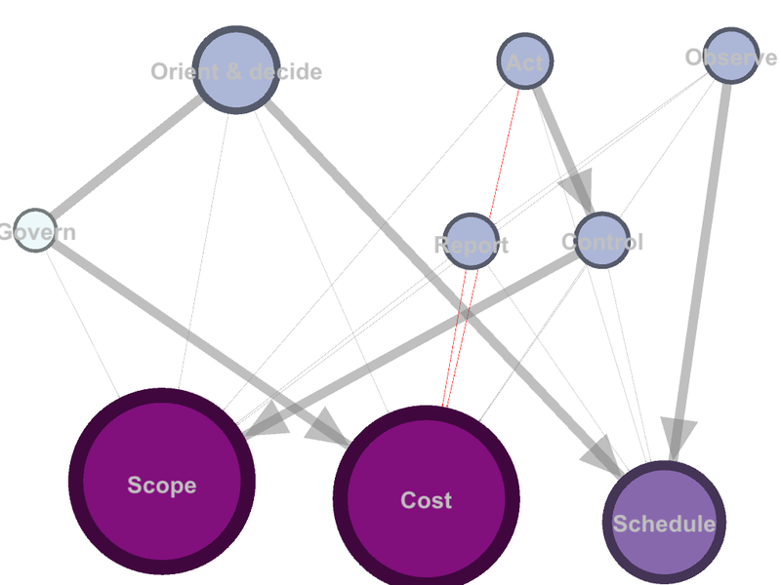

Slide 2
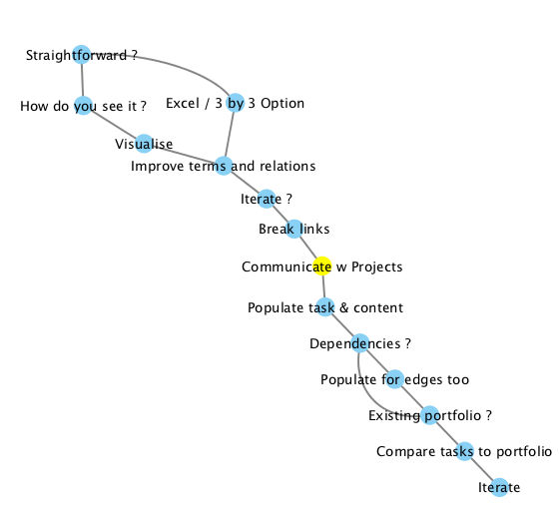
Straightforward ? | Is the Operating Model relatively straight forward ?
How do you see it ?* | Set down the different ways you all see the Model
Visualise* | Visualise those in Gephi or similar
Improve terms and relations | Improve the components of the model, and their relationships to each other
Iterate ? | Do you want to iterate towards a better Operating Model, whilst operating ? (or prepare a full Operating Model first ?)
Break links | Break links in the model, to show a simplified model for communication. This may be hierarchical or linear.
Communicate w Projects | Communicate with the Projects / Ops divisions
Populate task & content | Populate task and/or content modules for each component
Dependencies ? | Do you want to start thinking about dependencies yet ?
Populate for edges too | Populate task and content modules for each dependency as well
Existing portfolio ? | Do you have already have some sort of portfolio of projects that are working towards that Operating Model?
Compare tasks to portfolio | Compare your portfolio to your Operating Model and make first adjustments.
Iterate | Communicate, learn, measure and iterate*
Alternative Excel / 3 by 3 Option* | Start with an Excel or Gephi 3 by 3 / 3 by 4 model (OPTION)

Slide 3

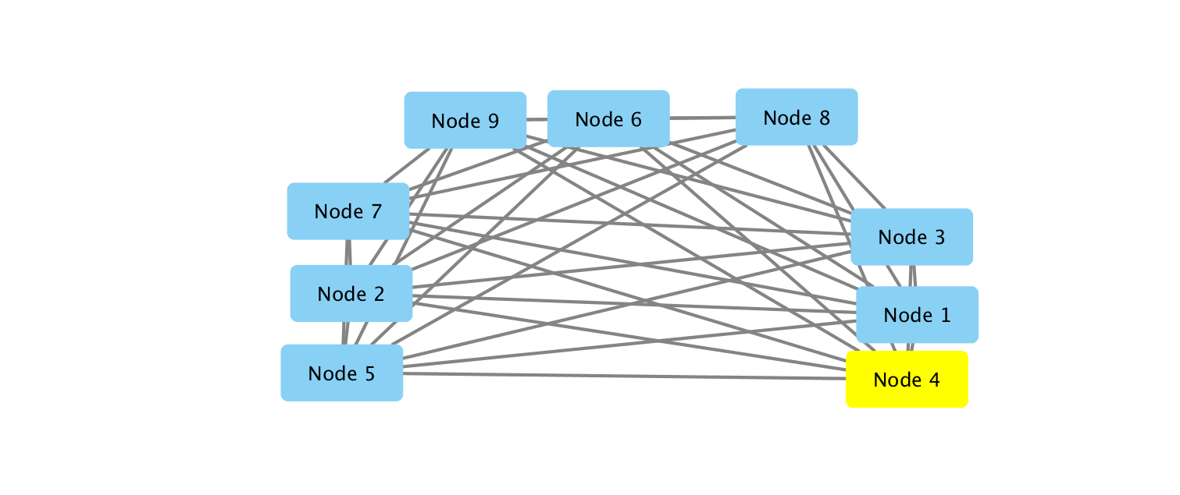
Is the Operating Model relatively straight forward ? | Do you already have a good Operating Model ? Or ideas to start from ?
↓Yes | ↓Yes
Start with an Excel or Gephi 3 by 3 / 3 by 4 model | Set down the different ways you all see the Model
 | ↓
↓ | Visualise those in Gephi or similar
↓
Improve the components of the model, and their relationships to each other
Examples
 | Assessment | Design | Implementation
Governance
Reporting
Controls

Slide 4
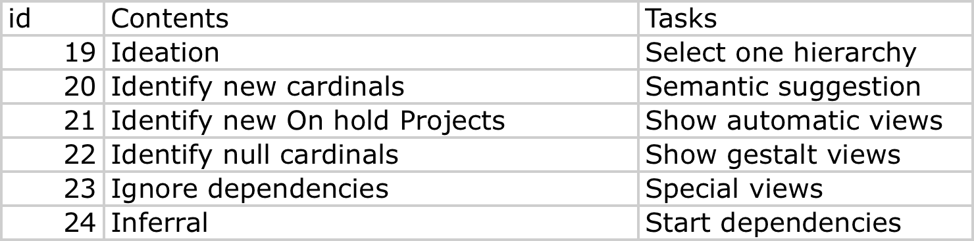
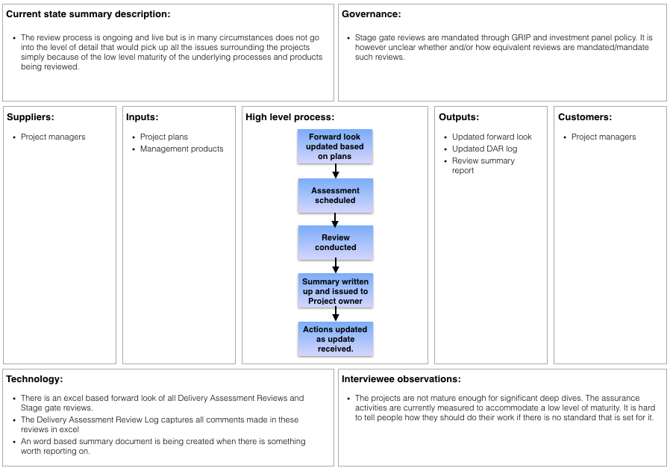
Do you want to iterate towards a better Operating Model, whilst operating ? (or prepare a full Operating Model first ?)
↓No | ↓Yes
Continue to improve and communicate the model, writing a full Strategy in parallel | Break links in the model, to show a simplified model for communication. This may be hierarchical or linear.
↓ | ↓
Continue into classical portfolio definition , waterfall style. END | Communicate with the Projects / Ops divisions
 | ↓
 | Populate task and/or content modules for each component
Examples
Operating Model Contents
 | Assessment | Design | Implementation
Governance | Governance baseline assessment | Portfolio options | First two cycles of Portfolio
Reporting | Reporting capability | Cost and schedule options | Basic reporting for 2 cycles
Controls | Controls capability | Change control and schedule | Change implementation for two cycles
Operating Model Tasks (i.e. candidate projects)
 | Assessment | Design | Implementation
Governance | Complete | Complete | Develop full capability
Reporting | Rationalise against IPA standard | Bring in NRT experience | Review
Controls | Convert Prince | Complete | Agree with Peter

Slide 5
No | Do you want to start thinking about dependencies yet ?
↓ | ↓ Yes
N/a | Populate task and content modules for each dependency as well
↓
Do you have already have some sort of portfolio of projects that are working towards that Operating Model?
↓
Compare your portfolio to your Operating Model and make first adjustments. Do the same for content modules if appropriate regarding the Operating landscape. What should we retain, and what have we missed ?
↓
Communicate, learn, measure and iterate*
Not thinking about dependencies
 | 4 | 5 | 6
1
2
3
Thinking about dependencies
 | 1 | 2 | 3
4 | 7 | 8 | 9
5 | 10 | 11 | 12
6 | 13 | 14 | 15
6 projects and Content modules. Or up to 15 Project and Content modules
Compare with Operations manual chapters
Compare with portfolio

